Slide 1
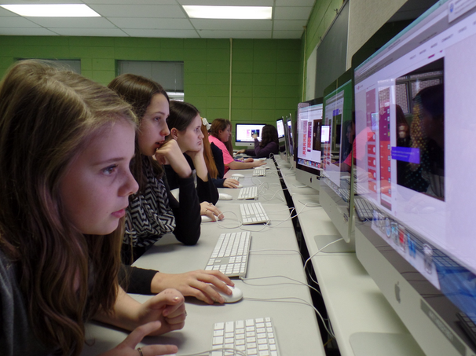
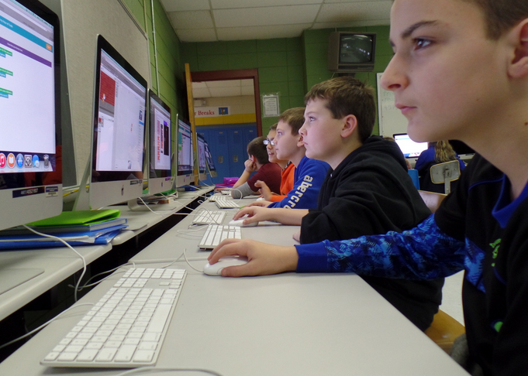
Empowering Students through Writing in the Math and Language Arts Classrooms
Classroom Teachers Enacting Positive Solutions/KyNT3

Slide 2
Classroom Teachers Enacting Positive Solutions/KyNT3
SABRINA BACK, NBCT
Jenkins Independent Middle School
&
SHANNON BRICKLER, NBCT
DRY RIDGE ELEMENTARY

Slide 3
SOME STATISTICS:
70% of students in grades 4-12 are low-achieving writers (Persky, et al., 2003).
Nearly 1/3 of HS graduates are not ready for college level English comp (ACT, 2005).
A 2002 NAEP finding from analysis across
three grade levels revealed that only 22-26% scored proficient in writing.

Slide 4
THE RESEARCH:
According to Dudley-Marling, et al., struggling writers do not need access to a remedial curriculum. Too often, curriculum of this type features an overemphasis on skills and mechanics, rather than the same high-quality writing instruction provided to more academically-successful peers.

Slide 5
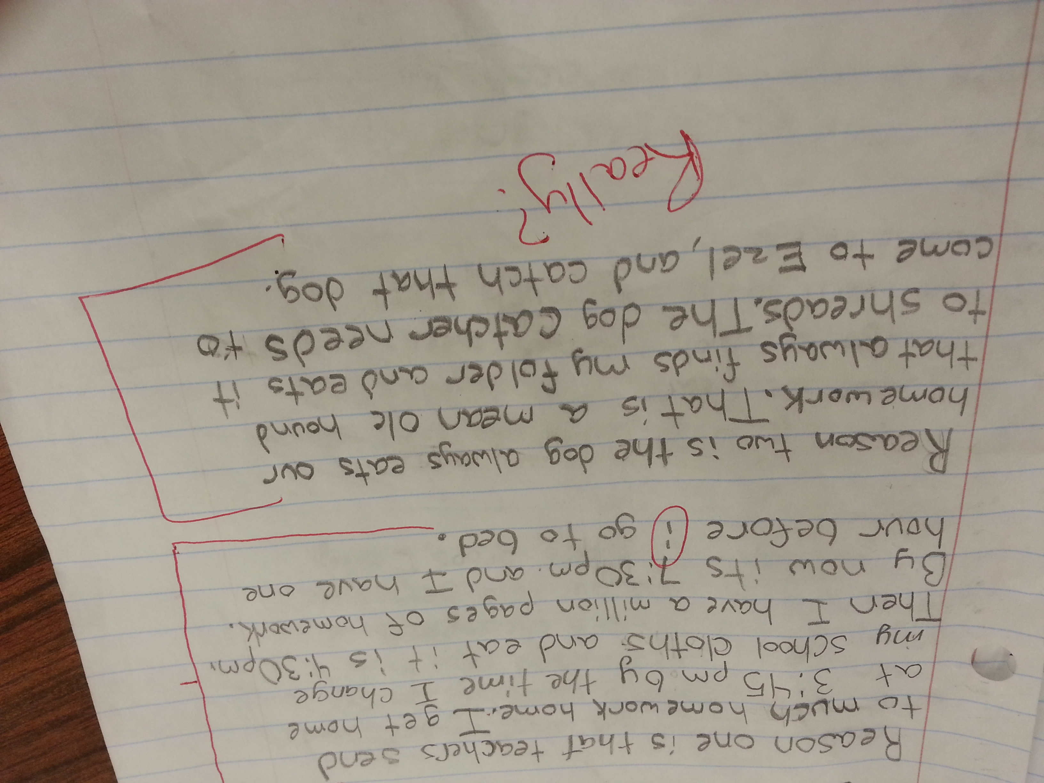

Slide 6
In a longitudinal study, teacher-researcher Elizabeth Langer found that the process of “envisionment building” through class discussion, allows struggling students access to the thinking mechanisms of their peers, thus providing those same students an entryway to the learning present in the room.

Slide 7
And, according to Integrating Writing and Math (Wilcox & Monroe):
…Quality of classroom discussion was richer when students are expected to write.

Slide 8
A possible plan of action to combat these issues is offered through Writing Next:
Writing strategies 10) Study of models
Summarization 11) Writing for content learning
Collaborative writing
Specific product goals
Word processing
Sentence combining
Prewriting
Inquiry activities
Process writing approach

Slide 9
Focus
Study of Models
Process Writing Approach
Pre-writing
Writing Strategies
Specific Product Goals
Collaborative Writing

Slide 10
Photo by liverpoolhls - Creative Commons Attribution License https://www.flickr.com/photos/107733654@N04
Created with Haiku Deck

Slide 11
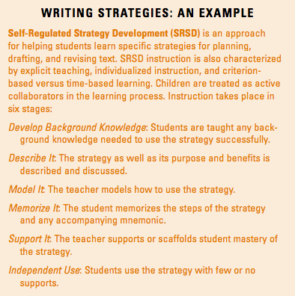
Notes:
From Writing Next

Slide 12
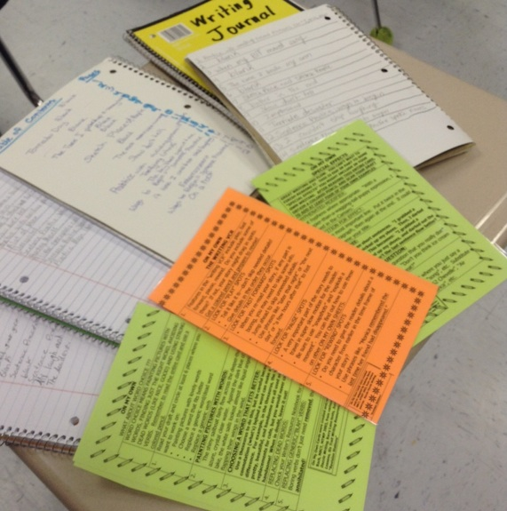
On My Own cards

Slide 13
Number Talks Key Components
Classroom environment and community
Classroom discussions
The teacher’s role
The role of mental math
5. Purposeful computation problems
Notes:
What is a number talk? Link this strategy to prewriting. Add Short video clip

Slide 14
Number Talk Video: Student Discourse

Slide 15
Student Discourse
“When I learned Identity Property in 3rd grade, I though it was stupid because everybody knows that. Now I know, we were doing 6 x 2/3 and Kaleb said, ‘I did reasoning, since 1 x 6 equals 6, 2/3 is less than 1 so it would be less than 6.’ And that’s when I finally found out, its not stupid.”
Parker S. (5th Grade Student)

Slide 16
Student Sample
242 x 0.5
Well I noticed that you will never get a decimal with an even number and if you do one with an odd number you will have a decimal and the reason that you will get a decimal is maybe the number was 333 x 0.5 Well you know 300 ÷ 2 is 150 so then you do 30 ÷ 2 = 15 Then you get down to 3 ÷ 2 which don’t come out as a whole number it comes out as 1.5 so that’s why you will get a decimal for odd numbers now if you were doing even numbers for example the problem we just did 242 x 0.5 is even so 200 ÷ 2 = 100 and 40 ÷ 2 = 20 2÷2=1 so if you add those numbers up you will get 121 now another thing that I noticed is that both ways will get your answer.
Chris (5th Grade Student)
Notes:
Student samples for participant review will be located at the tables.

Slide 17
Self Assessment: Writing about Number Talks
Reasoning and Proof _____ I clearly explain my thinking mathematically. _____Someone reading my journal would understand my thinking. _____ I can justify my thinking with mathematical evidence. _____ My math work is correct, and I’m able to prove this using another strategy. | Attend to Precision _____ I use a variety of specific math vocabulary. _____ I use the math vocabulary correctly and in the correct context.

Slide 18
Self Assessment: Writing about Number Talks
Connections _____ I can relate the problem that I’m writing about to other similar problems. _____ I can write about connections to other types of math problems and explain how they are connected. _____ I can make generalizations about the solutions and if they will work on similar problems. | Model ____ I can represent this problem in a different way. ____ I can create a visual for this problem. ____ I can create an equation/word problem for this problem.
______ I started each sentence with a capital. _______ I used punctuation at the end of each sentence. ______ I wrote complete sentences. | Reflection I am on track with ________________________________ I need to improve __________________________

Slide 19
Teacher Rubric
 | Satisfactory | Needs Improvement | Unsatisfactory
Reasoning and Proof | The student is able to explain his/her thinking. Mathematical evidence is used to support student thinking | The student is able to explain some or part of his/her math thinking. There is little mathematical evidence to support student thinking. | The student wrote something but no evidence of math thinking. There is no mathematical evidence to support student thinking or incorrect mathematical evidence is used.
Attend to Precision | The student communicates by using clear and precise math language. | The student communicates by using some math language. The student does not always use appropriate terminology. | The student does not communicate using math language.
Connections | The student makes mathematical connections to extend to other mathematics or to a deeper understanding of mathematics. Examples may include patterns, structures, and generalizing. | The student makes some attempt to make mathematical connections. The connection may contain some mistakes. | The student makes no mathematical connections.
Model | The student represents problems in multiple ways including words, drawing pictures, using objects, making a chart, list, graph, recreating equations, etc. | The student attempts to represent a problem in multiple ways, but has inaccurate information | The student does not represent a problem in multiple ways.

Slide 20
Math Practices
Makes sense of problems and perseveres in solving them.
Reason abstractly and quantitatively.
Construct viable arguments and critique the reasoning of others.
Model with mathematics.
Use appropriate tools strategically.
Attend to precision.
Look for and make use of structure.
Look for and express regularity in repeated reasoning.

Slide 21
The Research
Classroom mathematics discourse plays a central role in shaping mathematical capability and disposition.
Students cannot learn mathematics with understanding without engaging discussions.
The art of communication has to be taught.
Math Essential Research: The Role of Pedagogy in Classroom Discourse, Margaret Walshaw & Glenda Anthony

Slide 22
The Four Intentions behind Teacher Behavior in a Class that Lets Kids Get Smart
1. to know what and how this individual student is thinking about the mathematics…Curiosity
2. to cause dialogue between and listening among students…Student Talk and Interaction
3. to provide encouragement, acknowledgement and safety for students to risk speaking…Climate
4. to make an idea more clear and accessible through models, visuals, and sequence of questions…Clarity
Research for Better Teaching, Inc.

Slide 23
Let’s Try It!
28 x 5
Notes:
Before completing number talk inform participants that they will write about this number talk focusing on connections. Have participants review checklist rubric on connections since they will self evaluate their writing.

Slide 24
Shannon Brickler@MathConnections
Sabrina (Tackett) Back@elarockstar
sabrina.tackett@jenkins.kyschools.us
shannon.brickler@grant.kyschools.us
Notes:
Sabrina will add ways to make contact

